Slide 1
Locality, Matrix Multiplication, and Affine Transformations
Advanced Compiler Techniques
Source: https://www.youtube.com/playlist?list=PLf3ZkSCyj1tf3rPAkOKY5hUzDrDoekAc7
Videos: 125 - 130

Slide 2
Part 1: Locality

Slide 3
Locality: What is it? Why do we want it?
Data locality refers to data accessed being near to each other, either in the spatial dimension, or the temporal dimension.
Spatial locality: Addresses which are spatially near each other get accessed. Example: A-1, A, A+1, A+2, etc.
Temporal locality: Same address is accessed again and again. Example: A, A, B, A, C, A, etc.
Caches exploit locality to reduce the (average) memory latency observed by the execution pipeline.
Typically more locality = More hits in caches = Faster Execution!

Slide 4
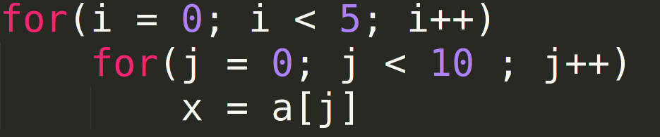
Interchanging Loops can affect locality

Slide 5
Reordering Loops can affect locality
High Spatial locality, low Temporal locality
a[0]
a[6]
a[1]
a[7]
a[2]
a[8]
a[3]
a[9]
a[4]
a[0]
a[5]
a[1]
Miss

Slide 6
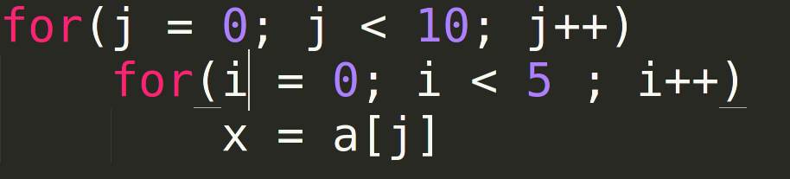
Reordering Loops can affect locality
High Spatial locality, high Temporal locality
a[0]
a[1]
Miss
Hit

Slide 7
What parameters affect locality?
Spatial: Prefetchers + CL size
Temporal: Replacement Policy

Slide 8
Part 2: Matrix Multiplication

Slide 9
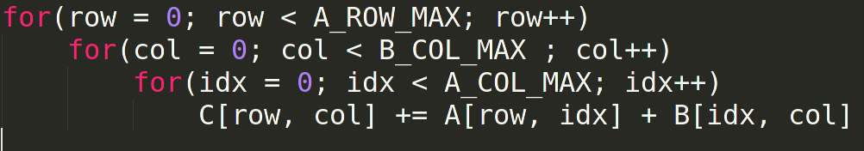
Matrix Matrix Multiplication
C[row, col]: Can be reg allocated. One time cost.
A[row, idx]: No point in reg allocating. Might need to pay for every access.
B[row, idx]: No point in reg allocating. Might need to pay for every access.

Slide 10
Matrix Matrix Multiplication
Worst case: A -> Column major, B -> Row major
Best case: A -> Row major, B -> Column major
Realistically, if both A and B are row major, and B_COL_MAX is sufficiently large, every access to B[idx, col] misses in cache. O(n³) misses.

Slide 11
Matrix Matrix Multiplication
However, if
There are more cache lines than there are rows in B
More than 1 element of B can completely in a cache line
The inner two loops will only have to face O(n²/C) misses when the first column would be accessed where C = Cache Line Size / Size of one element of B = number of columns of B that can fit in the cache.
In best case when we have sufficiently high number of cache lines, all columns of B will fit, reducing the total penalty to O(n²/C) for all three loops

Slide 12
What about A and C?
Fastest moving index for both A and C is the columns. Therefore, if A and C are row-major, then we only need to pay O(n²/C) for each of them.
Therefore in total we pay around 3n²/C.
If C > n, we don’t get any benefit as then useless data gets fetched into cache. If C = n, we pay around 3n penalty. This makes sense as we need n access for each matrix to bring the matrix into the cache. n accesses because each access brings a complete row, and there are n rows.

Slide 13
Matrix Matrix Multiplication

Slide 14
Blocking Matrix Multiplication
X
=

Slide 15
Blocking Matrix Multiplication
Best case, each block faces 3B²/C misses (B²/C for each sub-matrix). If each element is one byte long:
C = cache line size = l
Total (n/B)³ block operations.
Therefore total cost = 3n³/BC
B <= n and C <= n. Therefore, best case we get 3n penalty. This matches the best case estimate from earlier.

Slide 16
Part 3: Affine Loop Transformations

Slide 17
What does affine mean?
An affine expression is a linear expression of the inputs.
f(x₁, x₂, x₃, …., x_{n}) = c₀ + c₁x₁ + c₂x₂ + ….. c_{n}x_{n}

Slide 18
When can we use polyhedral optimizations?
Even if accesses are affine, there might be dependencies.
Upper and lower bounds of loops are affine functions of outer loop variables.
Increments are by 1. This can be achieved by using a placeholder variable in loop and multiplying it by a constant before use.
Under this assumption, the iteration space will always be convex.

Slide 19
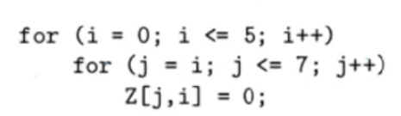
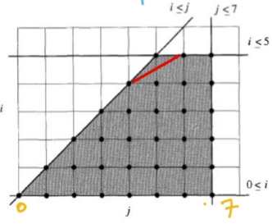
Example

Slide 20
Categories of Affine Transformations
Splitting iteration space into independent slices which can be executed parallely.
Blocking to create a hierarchy of iterations to improve locality.

Slide 21
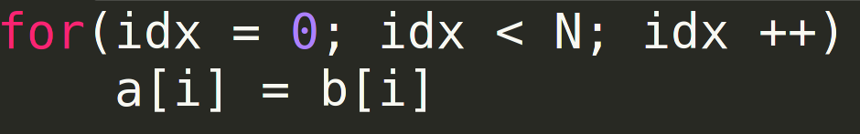
Example: Splitting Into Parallel Slices

Slide 22
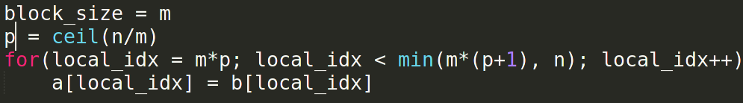
Example: Splitting Into Parallel Slices

Slide 23
Affine Transform Theory: Three Spaces
Iteration space: Set of all dynamic execution instances, i.e. all possible combinations of iterators. May/May not be rectangular.
Data space: Set of array elements accessed. Typically defined as an affine functions of the iteration space.
Processor space: Set of all processors in the system. We create an affine function map from iteration space to processor space.

Slide 24
Iteration Space Example
i >= 0
i <= 5
j >= i
j <= 7

Slide 25
Iteration Space Example
i >= 0
-i + 5 >= 0
-i + j >= 0
-j + 7 >= 0

Slide 26
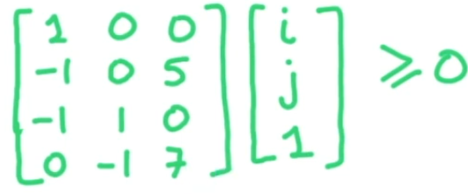
Iteration Space Example

Slide 27
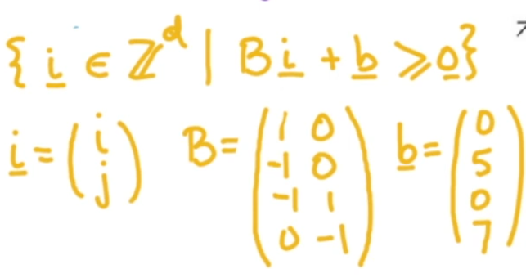
Iteration Space Example

Slide 28
Iteration Space Example: Execution order
Fastest moving variable is lexicographically smaller.

Slide 29
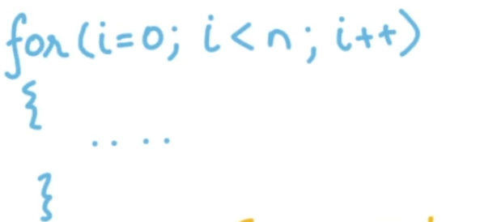

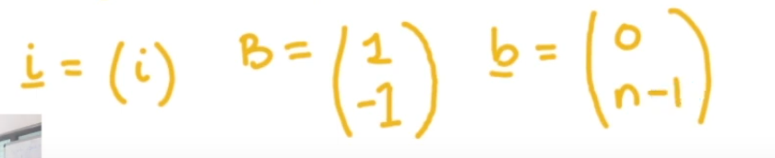
Iteration Space: Loop Invariant

Slide 30
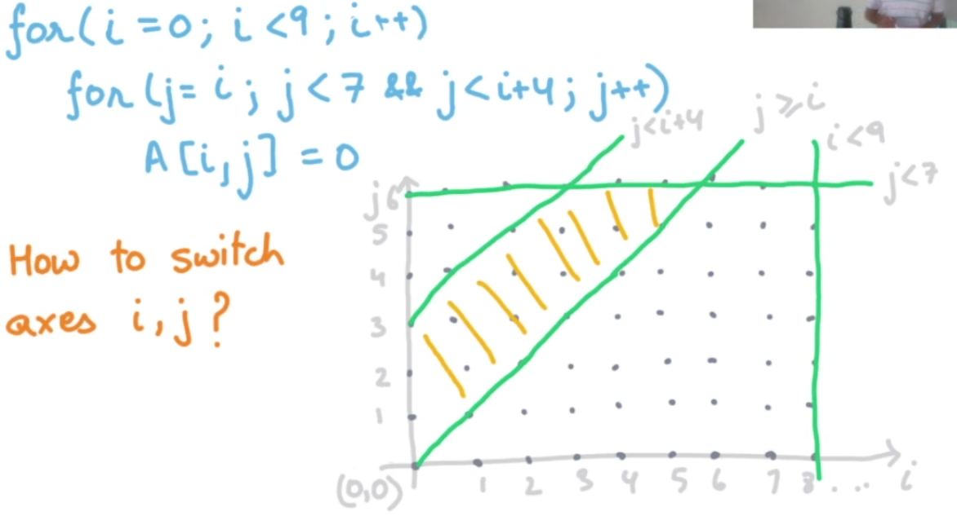
Exchanging Variables
Suppose we want to exchange i and j

Slide 31
Exchanging Variables
Project the iteration space on j to find the range of j.
For each j, find i in terms of j.
We are guaranteed to have another convex polyhedron after projection.

Slide 32
Exchanging Variables: Projection
The set of points (x₁, x₂, …, x_{m}) will be in the projection of S on m dimensions if for some (x_{m+1}, x_{m+2}, …, x_{n}), (x₁, x₂, … , x_{n}) lies in S.
Effective for every point in the projection, you should be able to find some set of values for the rest of n-m dimensions such that the n dimensional point lies in S.

Slide 33
Exchanging variables: Idea
Project the iteration space onto all the dimensions except the desired innermost variable’s dimension.
Then project the rest onto all the dimensions except the desired second-innermost variable’s dimension.
Then project the rest onto all the dimensions except the desired third-innermost variable’s dimension.
… and so on until all variables are exhausted.

Slide 34
Fourier Motzkin Method
Input:
A convex polyhedron S in m dimensions.
A variable x_{m} to eliminate
Output:
S’, a projection of S on all dimensions except the m^{th} dimension.

Slide 35
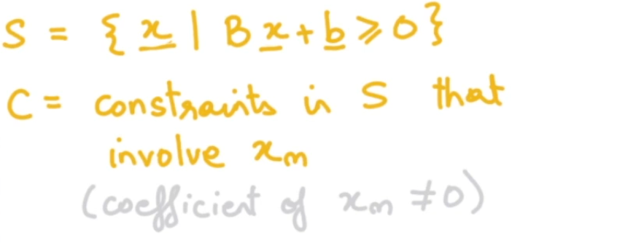
Fourier Motzkin Method: Terminology

Slide 36
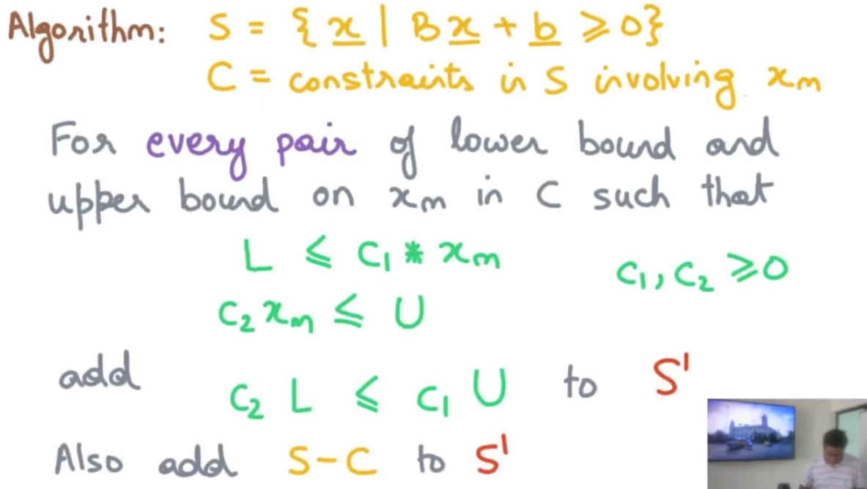
Fourier Motzkin Method: Algorithm

Slide 37
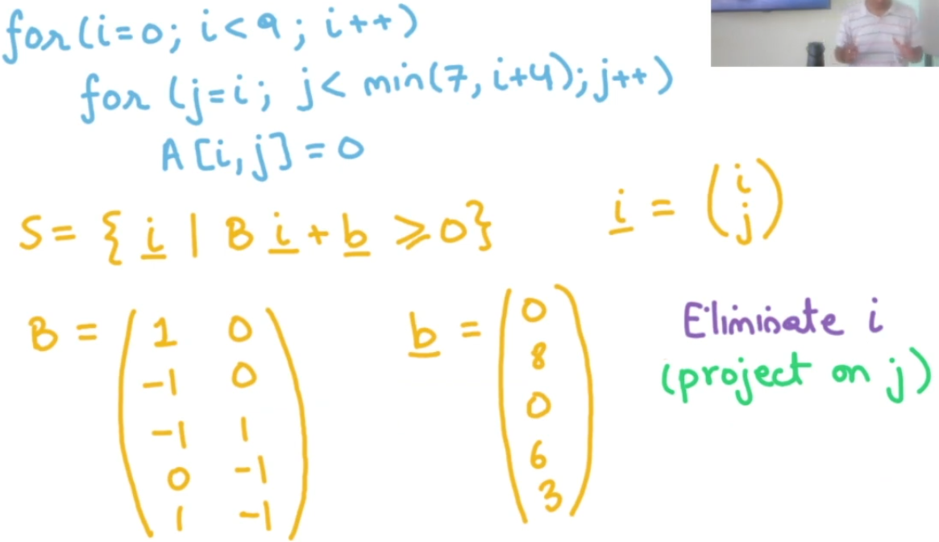
Fourier Motzkin Method: Example Setup

Slide 38
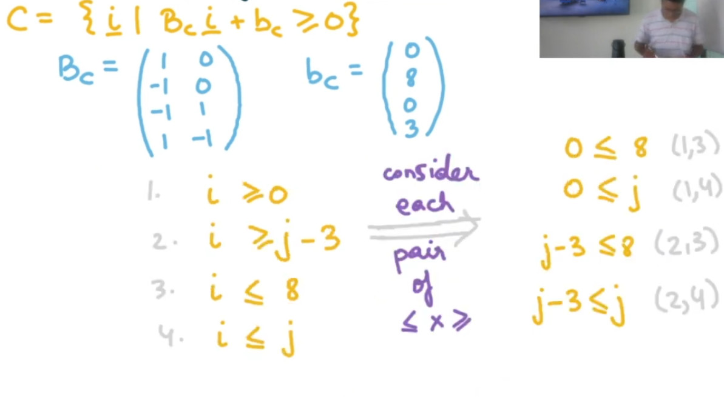
Fourier Motzkin Method: Example Solution

Slide 39

Example Solution

Slide 40
Thanks!
-Setu Gupta

